Slide 1
Spoken Digit Recognition Experiment
Vincent Baker
Drexel University Department of Physics

Slide 2
Experiment Description
Recognize spoken digits 0-9
Free Spoken Digit Dataset,
4 speakers, 50 trials of each digit
Filter each audio clip to create 9 distinct bands, inject bands into an ensemble of 9 columns (each column will be 2x2x100)
Lyon ear model has ~60 bands, we’ll start with 9 bands so we can use a reasonably sized column ensemble
Initial bands are 10-100 Hz, 100-150 Hz, 150-200 Hz, 200-300 Hz, 300-400 Hz, 400-500 Hz, 500-700 Hz, 700-1100 Hz, 1100-2000 Hz
After bandpass filter, rectify and lowpass filter to capture average power in band over time
Train a liquid state machine to recognize digits, evaluate on a test data set
See how classification performance changes with ensemble connectivity varied from “one big column” to completely unconnected columns

Slide 3
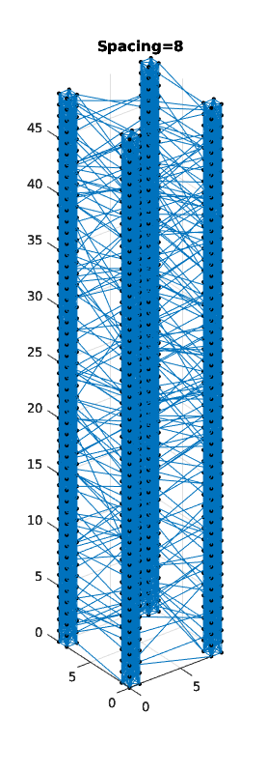
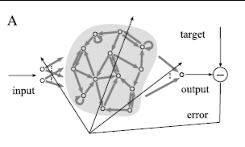
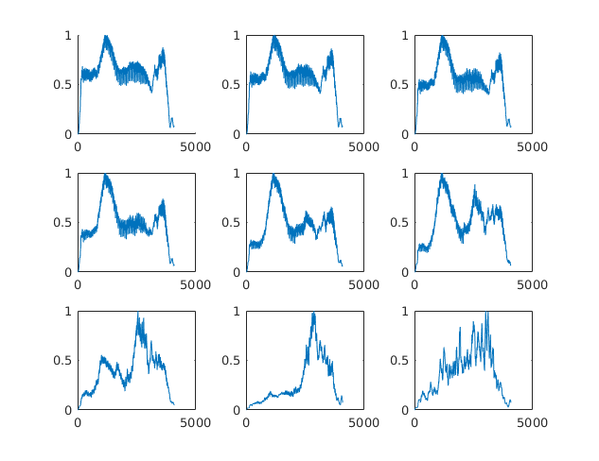
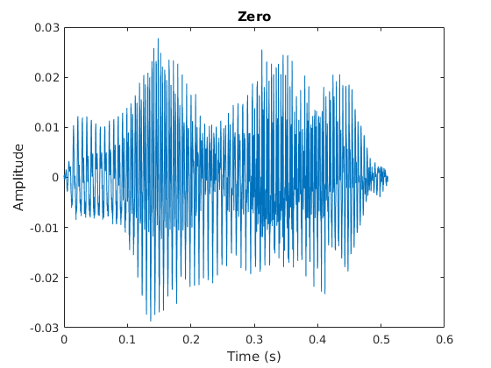
Processing flow
Train classifier to recognize digits based on firing activity in top layer of column ensemble
Audio file
Filter and rectify
Stimulate bottom of column ensemble, one band per column

Slide 4
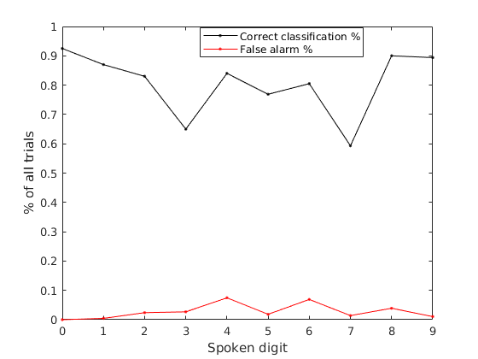
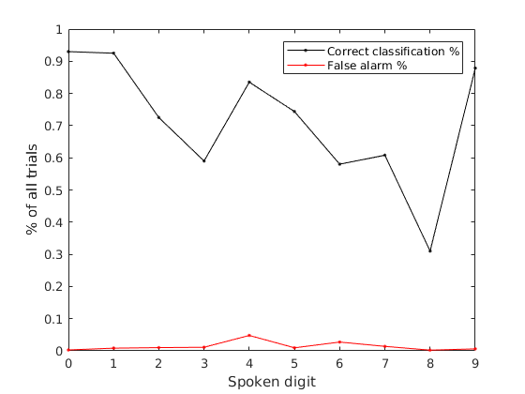
Initial results
Used MATLAB linear binary classifier (fitclinear) with default arguments
Used 100% of data for training and testing
For each digit, recorded % digit correctly recognized and % of other digits falsely recognized

